Slide 1
WEB UI- DRAG and DROP

Slide 2
DRAG and DROP
Drag and Drop has become a more familiar idiom on the Web.
Drag and drop seems simple. Just grab an object and drop it somewhere. What makes it challenging is that there are a lot of events during drag and drop that can be used as opportunities for feedback to the user.
There are a number of individual states at which interaction is possible. We call these microstates interesting moments. Eg:
• How will users know what is draggable?
• What does it mean to drag and drop an object?
• Where can you drop an object, and where is it not valid to drop an object?
• What visual affordance will be used to indicate draggability?

Slide 3
EVENTS
There are at least 15 events available for cueing the user during a drag and drop interaction.
Page Load: Before any interaction occurs, you can pre-signify the availability of drag and drop.
Mouse Hover: The mouse pointer hovers over an object that is draggable.
Mouse Down: The user holds down the mouse button on the draggable object.
Drag Initiated: After the mouse drag starts (usually 3 pixels).
Drag Leaves Original Location: After the drag object is pulled from its location or object that contains it.
Drag Re-Enters Original Location: When the object re-enters the original location.
Drag Enters Valid Target: Dragging over a valid drop target.
Drag Enters Specific Invalid Target: Dragging over an invalid drop target.

Slide 4
EVENTS
Exits Valid Target: Dragging back out of a valid drop target.
Drag Is Over No Specific Target: Dragging over neither a valid or invalid target.
Drag Hovers Over Valid Target: User pauses over the valid target without dropping the object
Drag Hovers Over Invalid Target: User pauses over an invalid target without dropping the object.
Drop Accepted: Drop occurs over a valid target and drop has been accepted.
Drop Rejected: Drop occurs over an invalid target and drop has been rejected.
Drop on Parent Container: Is the place where the object was dragged from special?

Slide 5
ACTORS
During each event you can visually manipulate a number
of actors.
Page (e.g., static messaging on the page)
Cursor
Tool Tip
Drag Object (or some portion of the drag object, e.g., title area of a module)
Drag Object’s Parent Container
Drop Target

Slide 6
Interesting Moments Grid
That’s 15 events times 6 actors. That means there are 90 possible interesting moments.
The grid is a handy tool for planning out interesting moments during a drag and drop interaction.
It serves as a checklist to make sure there are no “holes” in the interaction.
Just place the actors along the left hand side and the moments along the top.
In the grid intersections, place the desired behaviors.

Slide 7
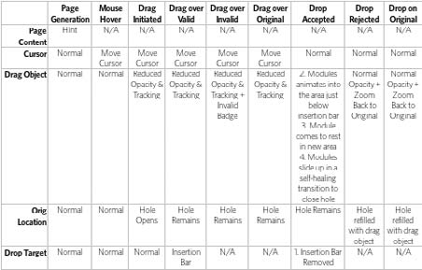
Interesting Moments Grid

Slide 8
Purpose of Drag and Drop
It is useful for
Drag and Drop Module
Rearranging modules on a page.
Drag and Drop List
Rearranging lists.
Drag and Drop Object
Changing relationships between objects.
Drag and Drop Action
Invoking actions on a dropped object.
Drag and Drop Collection
Maintaining collections through drag and drop.

Slide 9
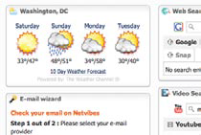
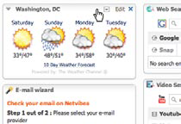
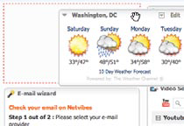
Drag and Drop Module
Normal display style
Modules are displayed without an explicit cue for drag and drop.
Invitation to drag
Moving the mouse to a module’s header changes the cursor to indicate that the item is draggable.
Dragging
The module being moved is dragged directly. A ripped-out “hole” is exposed where the module was dragged from.

Slide 10
Approaches for drop
While dragging, it is important to make it clear what will happen when the user drops the dragged object. There are two common approaches to targeting a drop:
Placeholder target
Insertion target

Slide 11
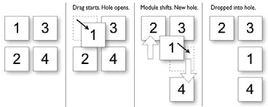
Placeholder Target
Uses a placeholder (hole with dashed outline) as the drop target. The idea is to always position a hole in the spot where the drop would occur.
When module 1 starts dragging, it gets “ripped” out of the spot. In its place is the placeholder target (dashed outline).
As 1 gets dragged to the spot between 3 and 4, the placeholder target jumps to fill in this spot as 4 moves out of the way.

Slide 12
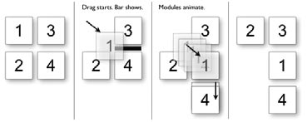
Insertion target
Keep the page as stable as possible and only move around an insertion target (usually an insertion bar).
While the module is dragged, the page remains stable. No modules move around. Instead, an insertion bar marks where the module will be placed when dropped.
Unlike with the placeholder target, the dragged module 1 is usually represented with a slightly transparent version of the module (also known as ghosting).
When module 1 is dragged to the position between 3 and 4, an insertion bar is placed there. This indicates that if 1 is dropped, then 4 will slide down to open up the drop spot.

Slide 13
Ghosting
Keep the page as stable as possible and only move around an insertion target (usually an insertion bar).
While the module is dragged, the page remains stable. No modules move around. Instead, an insertion bar marks where the module will be placed when dropped.
Unlike with the placeholder target, the dragged module 1 is usually represented with a slightly transparent version of the module (also known as ghosting).
The transparency (ghosting) effect communicates that the object being dragged is actually a representation of the dragged object. It also keeps more of the page visible, thus giving a clearer picture of the final result of a drop.

Slide 14
Best Practices for Drag and Drop Module
Use the placeholder approach when showing a clear preview during drag is important.
Use the insertion bar approach when you want to avoid page jitter.
Use the midpoint of the dragged object to determine drag position.
Use a slightly transparent version of the object being dragged (ghost) instead of an opaque version.
If you drag thumbnail representations, use the insertion bar targeting approach.

Slide 15
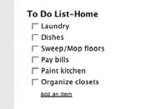
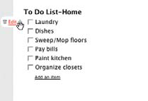
The Drag and Drop List for rearranging items in a list
Normal display state
List items are displayed without any indication that the items can be rearranged
Invitation to drag
One of the in-context tools revealed during mouse hover shows a four-way arrow indicating that the object can be moved.

Slide 16
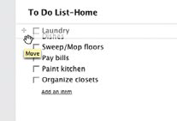
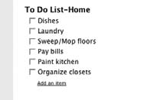
The Drag and Drop List for rearranging items in a list
Dragging
Rearranging occurs in real time. An empty slot is exposed where the dragged item will fit.
Dropped
The item snaps into the new location (where the hole was opened up).

Slide 17

Drag Lens
A drag lens provides a view into a different part of the list that can serve as a shortcut
target.
It could be a fixed area that is always visible, or it could be a miniature view of the list that provides more rows for targeting.
The lens will be made visible only during dragging.

Slide 18
Best Practices for Drag and Drop List
If possible, drag the items in a list in real time using the placeholder target approach.
Use the mouse position for drag target positioning.
If the goal is speed of dragging or if dragged items are large, consider using the insertion target approach, as rendering an insertion bar is inexpensive compared to dynamically rearranging the list.
Since drag and drop in lists is not easily discoverable, consider providing an alternate way to rearrange the list.
When the user rearranges the list with an alternate method, use that moment for a onetime advertisement for drag and drop.

Slide 19
Drag and Drop Object
Another common use for drag and drop is to change relationships between objects. This is appropriate when the relationships can be represented visually.
Drag and Drop Object is used to rearrange members of the organization

Slide 20
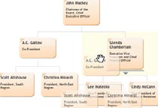
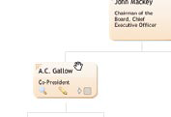
Drag and Drop Object
Normal display state
An organizational chart visually represents relationships.
Invitation to drag
When the mouse hovers over a member of the organization, the cursor changes to show draggability.

Slide 21
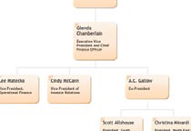
Drag and Drop Object
Dragging
An insertion bar is used to indicate where the
member will be inserted when dropped.
Dropped
When the dragged member is dropped, the chart is rearranged to accommodate the new location.

Slide 22
Best Practices for Drag and Drop Object
If objects are represented in a complex visual relationship, use insertion targeting to indicate drop location (minimizes disturbing the page during drag).
For parent/child relationships, highlight the parent as well to indicate drop location.
If possible, reveal drag affordances on mouse hover to indicate draggability.
Initiate drag when the mouse is dragged three pixels or if the mouse is held down for at least half a second.
Position dragged objects directly in sync with the cursor. Offsetting will make the drag feel disjointed.
When hovering over a draggable object, change the cursor to indicate draggability.

Slide 23
Drag and Drop Action
Drag and drop is also useful for invoking an action or actions on a dropped object.
Its most familiar example is dropping an item in the trash to perform the delete action.

Slide 24
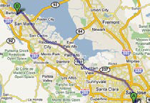
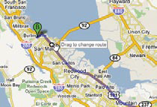
Drag and Drop Action
Normal display state
Route is shown in dark purple.
Invitation to drag
Hovering over any part of the route provides a draggable circle (route point) with a tool tip saying “Drag to change route”.

Slide 25
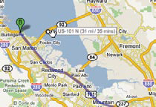
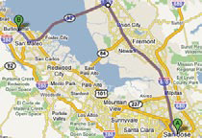
Drag and Drop Action
Dragging
We want to stay on the east side of the bay and cross the San Mateo bridge. Dragging the route
bubble back over the bridge will reroute our trip.
Dropped
The route changes as we drag. Dropping completes the rerouting action.

Slide 26
Best Practices for Drag and Drop Action
Use Drag and Drop Actions sparingly in web interfaces, as they are not as discoverable or expected.
Provide alternate ways to accomplish the action. Use the Drag and Drop Action as a shortcut mechanism.
Don’t use drag and drop for setting simple attributes. Instead use a more direct approach to setting attributes on the object.
Don’t construct an artificial visual representation for the sole purpose of implementing drag and drop. Drag and drop should follow the natural representation of the objects in the interface.
Provide clear invitations on hover to indicate the associated action.

Slide 27
Drag and Drop Collection
A variation on dragging objects is collecting objects for purchase, bookmarking, or saving into a temporary area.
This type of interaction is called Drag and Drop Collection.

Slide 28
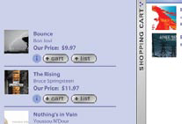
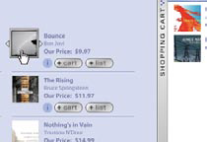
Drag and Drop Collection
Normal display state
The shopping cart is docked on the right part of the screen.
Invitation to drag
You can add to the cart with the “+ cart” button or you can drag the item to the shopping cart. If you use the button, the item flies to the cart; the cart bumps open and closed briefly to indicate that the item has been entered.
.

Slide 29
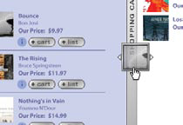
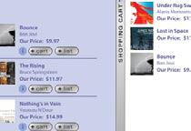
Drag and Drop Collection
Dragging
The item gets a dragging
treatment.
Dropped
The cart is populated with the new item.

Slide 30
Best Practices for Drag and Drop Collection
Use as an alternate way to collect items (e.g., a shopping cart).
When a drag gets initiated, highlight the valid drop area to hint where drop is available.
Provide alternate cues that drag and drop into collections as available.

Slide 31
General Best Practices for Drag and Drop
Keep page jitter to a minimum while dragging objects.
Initiate dragging if the user presses the mouse down and moves the mouse three pixels, or if she holds the mouse down for at least half a second.
Use drag and drop for performing direct actions as an alternate method to more direct mechanisms in the interface.
Hint at the availability of drag and drop when using alternatives to drag and drop.
Pay attention to all of the interesting moments during drag and drop. Remember, you must keep the user informed throughout the process.
Use Invitations to cue the user that drag and drop is available.

